Slide 1



Serbian Delegation Visit
Co-funded by the European Union
OECD Experience in South East Europe
Thursday, 13 September 2018
OECD Conference Centre, Auditorium

Slide 2
Agenda for today
Agenda for today
Present the general missions of the OECD, its governance and the role of public-private dialogue and public consultation processes within the Organisation
Present the mission and activities of the OECD South East Europe regional programme, highlighting consultations carried out as part of our work
Point to a few useful OECD references on PPD and PPC
Listen to your vision of the main challenges you are facing regarding PPD and PPC in Serbia and discuss potential solutions
2

Slide 3
The OECD

Slide 4
Fast facts
Established:
Headquarters:
OECD Centres:
1961
Paris
Berlin, Mexico City, Tokyo, Washington 36
Angel Gurría (Mexico)
~2 500
374 M€ (2017)
Members:
Secretary-General:
Secretariat staff:
Annual budget:
Nearly 300 expert committees and working groups
with participation of +100 countries

Slide 5
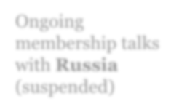

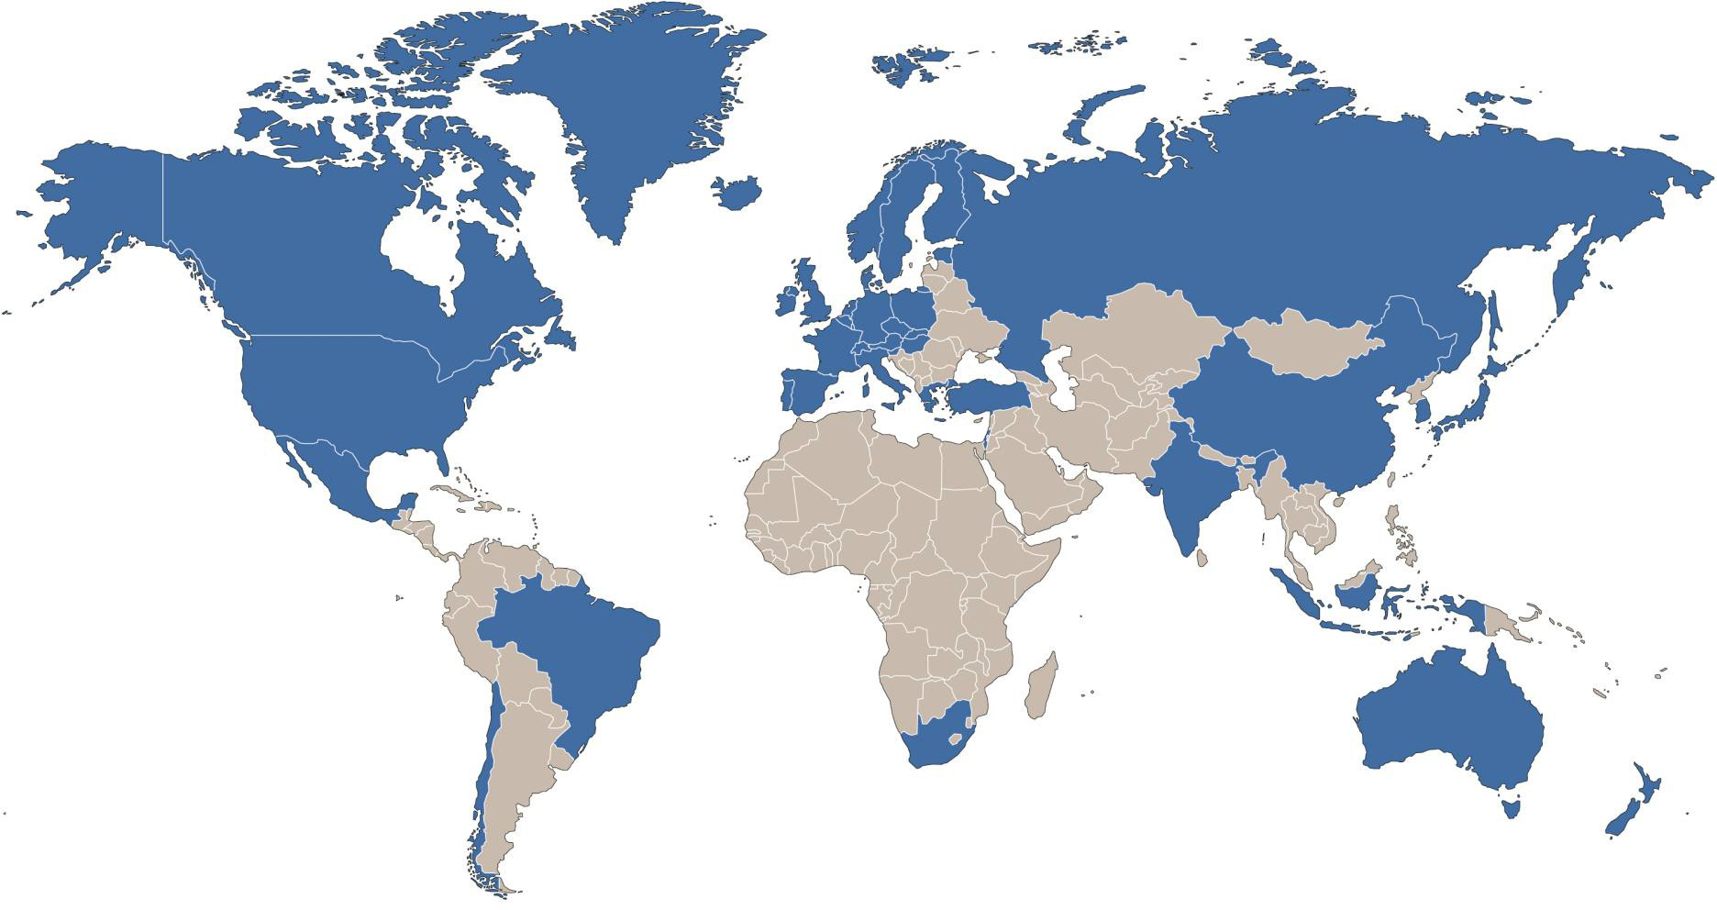
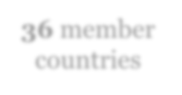

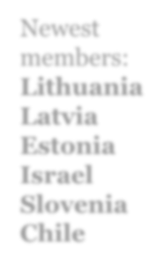

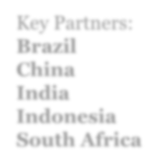

OECD’s global reach
Ongoing membership talks with Russia (suspended)
36 member countries
Newest members: Lithuania Latvia Estonia Israel Slovenia Chile
Key Partners: Brazil China India Indonesia
South Africa

Slide 6
Policy areas covered
Agriculture and fisheries Bribery and corruption Chemical safety and Biosafety
Competition Corporate governance Development Economy
Education Employment Environment Finance
Green growth and sustainable development Health
Industry and entrepreneurship Innovation
Insurance and pensions International migration Internet
Investment
Public governance Regional, rural and urban development
Regulatory reform Science and technology Social and welfare issues Tax
Trade

Slide 7
Who does what?
Council Oversight and strategic direction,
presided by the Secretary-General
Committees
National experts discussion, monitoring and
peer review
Secretariat
Research, analysis and policy recommendations

Slide 8
Characteristics of OECD work
Takes a multidisciplinary approach
Collaborates with many different ministries
Offers evidence-based, independent policy advice
Provides decisions via consensus
Monitors members’ progress through peer reviews
Seeks and sets best practice standards
Does not provide financial assistance

Slide 9
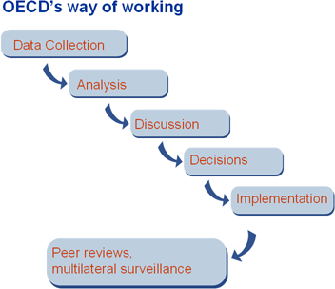
How we do it

Slide 10
Peer review
An initially unique method
Examination of each country’s policies and practices by experts from other countries - the examination is done by peers, i.e. policy makers who face similar problems in their countries. It is a discussion among equals.
Effective tool for policy improvement thanks to:
  Peer pressure
  The same methodology and criteria to assess performance for all countries
  Systematic and recurring monitoring mechanism
  Peer learning and capacity building

Slide 11
Business and trade unions representations at the OECD
Business and Industry Advisory Committee (BIAC)
International business network with global and cross-sectoral membership
Represents major business associations in OECD member countries and key partners
Communicates business perspectives in annual consultations with OECD ambassadors and OECD ministerials
Provides strategic counsel on OECD policy instruments
Trade Union Advisory Committee (TUAC)
Brings together over 58 national trade unions representing some 66 million workers in OECD countries
Access to OECD discussions enables proactive engagement in policy debate
Conveys trade union positions in annual meetings and OECD ministerials
Submits policy inputs to the OECD

Slide 12
The OECD South East Europe Regional Programme

Slide 13
The OECD and Serbia
Serbia is not a member of the OECD, but is an Invitee in 11 OECD bodies/projects and has adhered to 6 OECD instruments
  Participates in SIGMA
  Active member in the activities of the Anti-corruption Network for
Eastern Europe and Central Asia
  Member of the four programmes of the OECD Agricultural Codes and Schemes
  Full member of the International Transport Forum
Serbia’s contact point at the OECD is the Global Relations Secretariat
  Serbia participates in the SEE regional programme since its inception
13

Slide 14
Introduction to the OECD SEE regional programme
Provides policy advice to improve economic reform agendas and foster competitiveness & SME development in:
o Albania, Bosnia and Herzegovina, Bulgaria, Croatia, the Former Yugoslav Republic of Macedonia, Kosovo*, Moldova, Montenegro, Romania, Serbia and Turkey;
Close partnership with European Commission, which is main donor and relies on Programme’s work for its technical assistance programming.
Strong legacy: Established in 2000, it is the oldest regional programme at the OECD;
Local presence through high-level national project co-ordinators and
comprehensive in-country stakeholder networks;
2015 MCM Mandate for further strengthening OECD relations with SEE going forward;
New website: www.oecd.org/south-east-europe
*This designation is without prejudice to positions on status, and is in line with UNSCR 1244 and the ICJ Opinion on the Kosovo declaration of independence.
14

Slide 15
Overview of ongoing projects and activities
3 key work streams
Competitiveness Outlook
Small Business Act assessment
Economic Reform Programmes

Slide 16
An example of our work –
The Competitiveness Outlook in video

Slide 17
Methodology: Competitiveness Outlook & SME Policy Index
Phase 1
ASSESSMENT FRAMEWORK DEVELOPMENT by OECD with regional organisations and OECD experts
SELF-ASSESSMENT by SEE government officials |  |  | INDEPENDENT ASSESSMENT by OECD and local experts involving the private sector |  |  | OFFICIAL STATISTICS from SEE economies, and regional and international organisations
RECONCILIATION: ECONOMY AND REGIONAL LEVELS OECD, SEE government officials, regional organisations and private sector to reach consensus
ANALYSIS AND DRAFTING OECD, SEE government officials, regional organisations and experts to review and finalise
PUBLICATION LAUNCH At Summit/High-level-event and across the SEE region
Phase 2
Phase 3
Phase 4
Phase 5

Slide 18
Inclusiveness of projects:
Competitiveness Outlook & SME Policy Index
OECD GRS
Policy Analysts
OECD
Directorates
Regional Expert Organisations
International Experts
SEE
Governments
CO & SBA
Co-ordinators
Local Experts
Private Sector Representatives
Statistical Offices

Slide 19
Competitiveness Outlook: Main objectives and impact
The most wide-ranging assessment of economic policy performance of the Western Balkans today:
  17 policy dimensions key to economic competitiveness;
  6 economies: Albania, Bosnia and Herzegovina, the Former Yugoslav Republic of Macedonia, Kosovo*, Montenegro, and Serbia;
Change management tool for policy makers at various levels of government and across most government ministries and agencies for competitiveness-enhancing policy making;
Road map for regional economic policy reform;
Reference for the European Commission to build the EU enlargement process;
Catalyst for inter-ministerial co-operation and intra-regional integration;
Guide for investors to make informed investment decisions;
Toolkit for donors and international development agencies to prioritise funding choices;
A complete body of knowledge contributing to the research community and debate.

Slide 20
A broad scope: 17 policy dimensions
Sustainability / Economic Structure | Skills and Capacity | Business Environment | Governance
Agriculture Environment Energy Culture and Tourism Transport | Education and Competences Employment Digital Society Research, Development and Innovation | Investment Policy and Promotion Trade Policy and Facilitation Access to Finance Tax Policy Competition Policy State-owned Enterprises | Anti- corruption Effective Public Services

Slide 21
SBA Assessment: Main Objectives and Impact
Overall Objective of the Small Business Act Assessment:
Supporting the Private Sector Development in the Western Balkans and Turkey
The only comprehensive assessment of SME policies for the six Western Balkan economies and Turkey, its results are periodically reflected in the flagship publication SME POLICY INDEX – the next one to be published in May 2019.
A reference document for policymakers to benchmark against EU & OECD good practices and standards;
Improved SME policy-making and enhanced the capacity of policy-makers;
Encouraged co-ordination among ministries on cross-cutting SME Policies;
Resulted in more systematic collection of certain information and statistical data;
  Inclusive policy making by engaging private sector and civil society actors;

Slide 22
A broad Policy Scope: SME Policy Index based on Small Business Act for Europe principles
2
Access to finance
Dimension 6: Access to finance for
SMEs
1
Institutional, regulatory and operational
environment
Dimension 3: Regulatory framework for SME policy making
Dimension 4: Operational environment for SMEs
Dimension 2: Bankruptcy and second chance for SMEs
3
Human capital
Dimension 1: Entrepreneurial learning
and women’s entrepreneurship
Dimension 8a: Enterprise skills
4
Support measures for SME competitiveness
Dimension 8b: Innovation policy for SMEs
Dimension 5a: Support services for SMEs and start-ups
Dimension 5b: Public procurement
Dimension 9: SMEs in a green economy
5
SME internationalisation
Dimension 10: Internationalisation of
SMEs
Dimension 7: Standards and technical regulations
OECD South East Europe 22

Slide 23


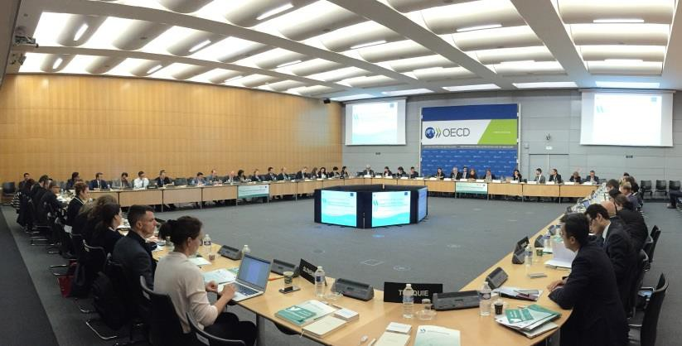
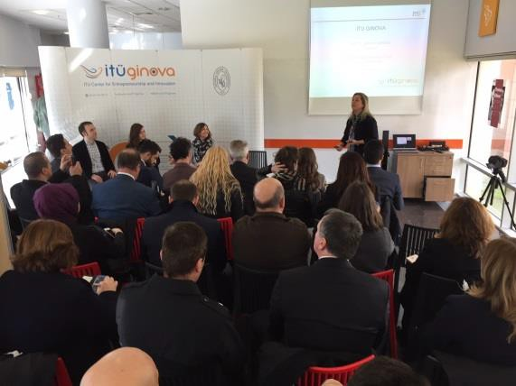
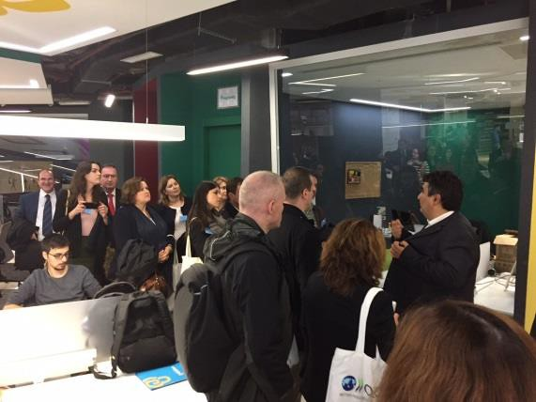
SBA Assessment – Support to Implementation
Assist policy makers in the SME Index recommendations’ implementation with
regional policy dialogue meetings and capacity building activities
  Peer learning at the core to foster regional co-operation in the Western
Balkans;
  Providing practical examples to policy makers by sharing OECD-EU good practices
  Enhancing the understanding and awareness of cutting edge SME policies
Regional Policy Dialogue
Capacity Building activities
1st meeting: “Alternative Financial Instruments”
2nd meeting: “Encouraging Linkages between SMEs and Multinational Firms”
3rd meeting: “Bankruptcy and Second Chance Policies”
4th meeting: “ SME Greening Policies”
A study visit to Istanbul on “SME and Academia Collaboration” to share Turkey’s Experience in Innovation and Technology Centres

Slide 24

Economic Reform Programmes (ERPs)– Objectives
Enable structural change for increased competitiveness of Western Balkan economies
Improve economic governance as a key requirement for EU
membership
Transition towards a functioning market economy as set out in the Copenhagen criteria
Foster inter-ministerial co-ordination to ensure coherency between macroeconomic projections, state budget expenditure and reform plans
Strengthen institutional capacities
to identify structural constraints, to develop and prioritise policy responses
to anticipate the potential impact of structural reforms on economic growth and job creation
to implement effectively reforms and monitor reform progress
Reinforce the policy-dialogue with civil society stakeholders

Slide 25
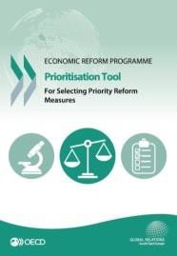
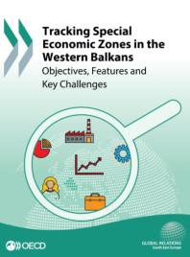
OECD’s role in the ERP cycle and recent outputs
Capacity Building
Analytical Support
Hands-on assistance to the ERP Co- ordinators and line ministries in building and enhancing institutional capacity to prepare the ERP
Substantive inputs through specific policy analyses and practical tools: guidance in the application, review the outputs, additional suggestions
Over 10 policy roundtables and capacity- building seminars conducted in Paris and SEE capitals
More than 500
government officials from SEE attended policy roundtables and seminars
ERP Tools provide practical guidance in the diagnosing constraints, prioritising and monitoring reforms
Report on SEZ with new insights on benefits and risks in the WB

Slide 26
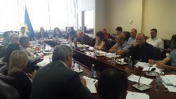
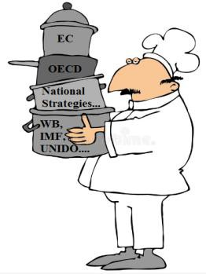
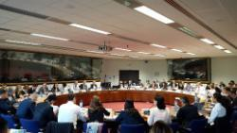
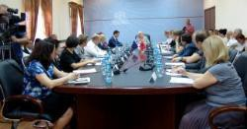



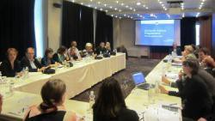
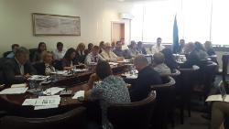

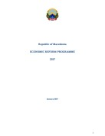
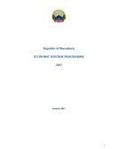
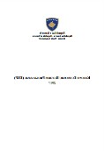
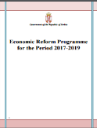

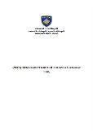
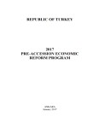
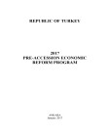
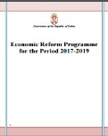
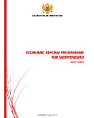

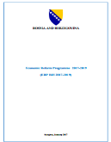
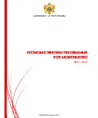
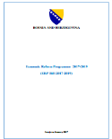
Process of the annual ERP cycle
August- September: Review of relevant sources and documents to provide ERP support.
May: ERP launch event in Brussels & bilateral meetings.
June - July: Kick-off events and seminars in the capitals.
November - December: Stakeholders consultations in the countries.
September - November: Policy seminars and capacity building events.
October - November: OECD reviews 1st ERP drafts.
December: OECD reviews 2nd ERP drafts.
31 January: Countries submit final ERP 2017-19 to the EC.
February - April: ERP assessment and new guidelines.

Slide 27
Some OECD resources on public-private consultations (PPCs)

Slide 28


Assessment of PPCs in the Western Balkans
Competitiveness Outlook 2018: chapter 16. Public Services in South East Europe
SBA Assessment:
SME Policy Index Dimensions
a
Entrepreneurial learning and women’s entrepreneurship (ETF)
Bankruptcy and second chance for SMEs (OECD)
3. Institutional and Regulatory framework for
SME policy making (OECD)
4. Operational Environment (OECD)
5. SME support services (OECD) and public procurement (OECD/SIGMA)
6. Access to finance for SMEs (EBRD)
7. Technical standards (OECD)
8. Enterprise skills (ETF) and innovation policy for SMEs (OECD)
9. SMEs in a green economy (OECD)
10. Internationalisation of SMEs (OECD)
Public-private consultations
Part of the assessment: sub-dimension 3.3
Evaluation of the frequency, transparency, formal influence and inclusiveness of public-private consultations
Dialogue with the private sector representatives important feature of the project
Examination of the effectiveness of the SME policies
through numerous interviews with businesses,
chambers of commerce and entrepreneurs
28

Slide 29


Assessment of PPCs in the Western Balkans (cont’d)
Main challenges in the Western Balkans
Consistent implementation of PPCs is still lacking despite the formal requirement to
conduct them: majority of gov. acts still adopted through an “urgent” procedure
Centralised on-line platforms for PPCs were introduced in majority of the WBT economies, yet they are underutilised
Councils to facilitate consultations with interested parties are increasingly being
formed, but their effectiveness is dubious
Systematic efforts to improve the quality and effectiveness of PPCs are generally lacking: no bodies that oversee the implementation of consultations and check for their quality
OECD South East Europe Regional Programme 29

Slide 30
OECD Good practices on PPCs (1/3)
Denmark’s Business Forum for Better Regulation
Aim: identify areas where companies experience the greatest burdens and propose simplifications (changing rules, introducing new processes or shortening processing times)
Members of the Business Forum: industry and labour organisations,
businesses, as well as experts with expertise in simplification.
How it works: meets 3 times a year to decide which proposals to send to the government. The Forum defines themes where simplification of regulation was most promising. Within these themes, specific changes are proposed by the Forum (in total 13 themes). Proposals from the Business Forum are subject to a "comply or explain" principle. This means that the government is committed to either implement the proposed initiatives or to justify why initiatives are not implemented.
Key strengths: The “comply or explain” principle and the openness of the forum together with the direct input from businesses and business organisations ensuring that the proposals represent the needs of the business sector.
Results: by October 2016: 603 proposals were sent to Government, of which so far 191 were fully and 189 partially implemented; annual burden reduction of the
initiatives estimated at ~EUR 100 M
30

Slide 31
Good practices on PPCs (2/3)
ICT tools in fostering PPCs - the Slovak Republic’s government
consultation portal
Aim: provide a single access point for public authorities as well as the general public to comment on legislative proposals and non-legislative drafts.
How it works: members of the general public must register at the government portal and can then submit written comments on any legislative proposal. Written comments can either be submitted as INDIVIDUAL or as “COLLECTIVE COMMENTS”, to which individuals or organisations can signal their support. Whenever a comment receives support from 500 individuals or organisations, ministries are obliged to provide written feedback on the comment either taking the comment into consideration for the legislative proposal or explaining why the comment has not been taken into account. The feedback provided is then part of the dossier submitted to the government for discussion.
Key strengths: possibility to use its structure at all stages of the legislative process
Results: practically all legislative proposals are adjusted following the
consultation process
31

Slide 32
Good practices on PPCs (3/3)
Finland’s website for early-stage consultations “Have your say” (otakantaa.fi)
Aim: as part of the “E-participation environment” project which lasted from 2010-2014, the eParticipation platform otakantaa.fi was relaunched in order to enable better interaction with the broader public during the early phase of policy-making.
How it works: the website allows both public officials and members of the general public to start discussions on various topics (from drafting new laws to mapping needs and ideas for new policies). On the platform, projects and initiatives are categorised by geography (i.e., if a topic is specifically relevant for certain cities or regions within Finland) and by keywords which can be chosen by the initiators of projects. To participate, two different tools exist: discussion forums and web surveys. The inputs vary between long and detailed comments with some idea or evidence and short opinions or votes signalling participants’ agreement or disagreement. The initiator provides a summary of the discussions or the results of the survey, which is attached to other drafting material used in the decision-making process.
Key strengths: platform is flexible and simple, possibility to use its structure at all stages of the legislative process; feedback collected in a short time thanks to the tools
Results: by January 2016, 354 projects or initiatives have been started.
32

Slide 33
Relevant OECD work on PPCs
Recommendation of the Council on Regulatory Policy and
Governance (2012)
OECD Regulatory Policy Outlook (2015)
Regulatory Policy by Country (2015)
Measuring Regulatory Performance (2015)
Indicators of Regulatory Policy and Governance: Design, Methodology and Key Results (2015)
Pilot database on stakeholder engagement practices in regulatory policy (2016)
Annual Country Assessment Reports (WBT region)
  Competitiveness Outlook (2018)
  SME Policy Index 2019 (to be published in spring 2019)

Slide 34


Thank you for your attention!
Co-funded by the European Union
For further information, please consult our new website:
www.oecd.org/south-east-europe
and contact:
Ms. Marzena KISIELEWSKA
Head of the OECD South East Europe Division
e-mail: marzena.kisielewska@oecd.org

